Slide 1
Accessing The Curriculum for Diverse Learners
Individualized Education Plan

Slide 2

Individualized Education Plans (IEP)
First introduced in US (Public Law 94-142) in 1975
Mandated (legal) in US, not in BC
Considered confidential
Developed to support a student to reach their education goals

Slide 3
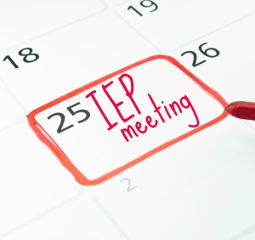
IEPs
Tailored to a specific student
Strength based
Regularly maintained and updated yearly, until leaving school (19 years old)
Collaborative with parent and student
Student assessment is teacher’s responsibility

Slide 4

Student’s involvement in the IEP
Builds self-advocacy skills and self-esteem
Gives a student some control over their education
Builds important social and conversational skills
Teaches the processes of decision-making, goal setting and achievement
Notes:
.

Slide 5

Activity: BC Ministry of Education IEPs for Students with Special Needs
Form small groups.
Share your questions with the group.
Answer together by referring directly to the ministry document for verifying responses. Record in the right column on your reading response sheet.
As a class discuss any questions that remain unanswered.

Slide 6
A Parent’s Perspective
“Advice for Professionals Who Must Conference Cases”
by Janice Fialka, parent, writer and advocate for students with disabilities; text page 135

Slide 7

Activity: Video response
Watch simulated videos from Community Living Ontario – Inclusive Education
Complete PMI (plus, minus, interesting/implications)

Slide 8

EA Role
EA participates
Makes suggestions
Ask questions
Seeks clarification
Shares insights
EA implements
Shares strategies with other involved EAs to ensure consistency of support to student

Slide 9


IEPs

Slide 10

Activity: IEP scenarios
In small groups read your assigned scenario.
Consider that you were not present at the IEP meeting, but are expected to implement the various strategies.
What clarifying questions do you have for the classroom or resource teacher to ensure you understand the strategies you are expected to deliver to support this student’s learning?

Slide 11
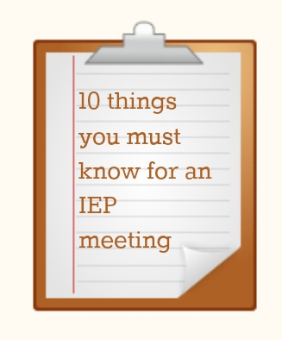
Activity: 10 things
Create a flow chart or poster (with simple visuals) that outline the 10 most important things to remember about an IEP and the development process.

Slide 12

Read
A Parent’s Guide to UDL – next class
Inclusive Teaching (p.218-224 & 361-364)
Inclusion of Exceptional Students (p. 6-9 & 238-243

